Slide 1
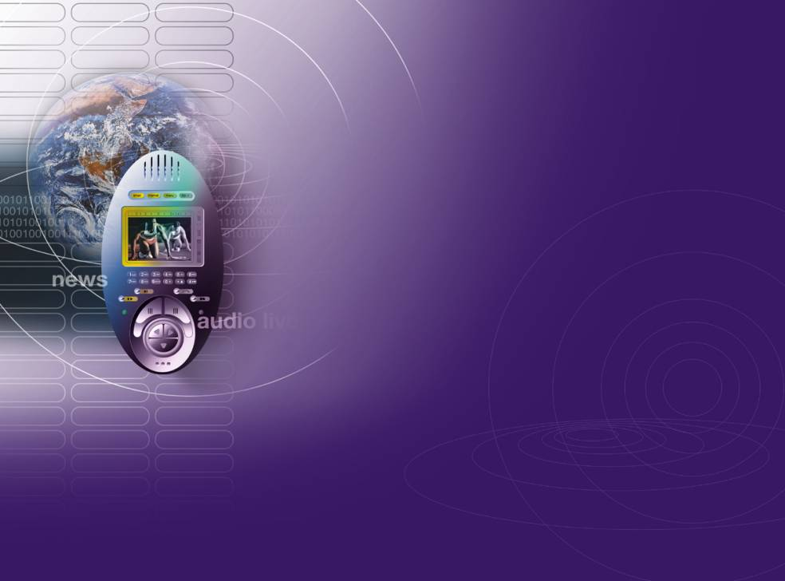

MVCE & Business Models
25th May 2011
Jason Williams - Orange
User Interactions for Breakthrough Services
Notes:
1

Slide 2
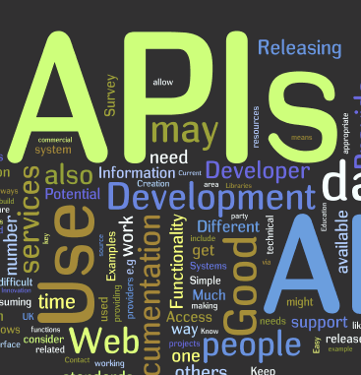
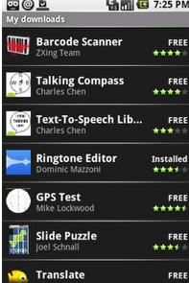
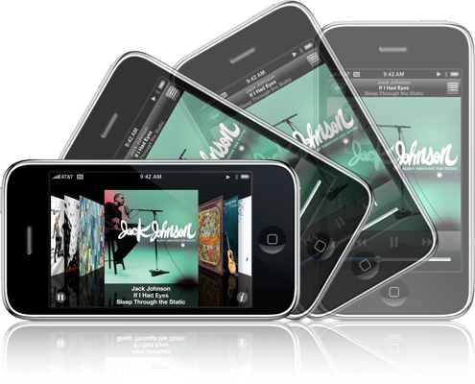
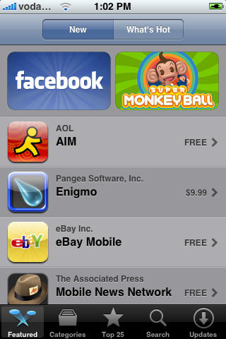

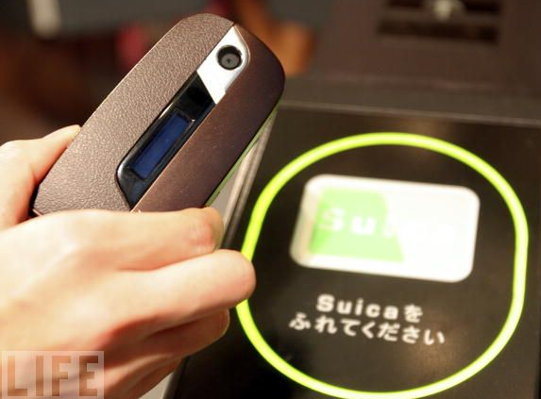

Key Trends
Intercommunication
App Stores
New Interaction Methods
Environment Interaction
Social Networking
The Cloud

Slide 3
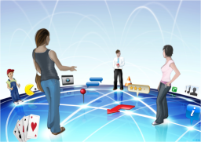
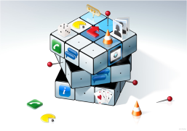
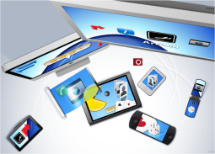
User Interactions For Breakthrough Services
  19½ Man Year programme
  2008 – 2012
  Research by 4 Universities guided by Industrial Consortium
  Looking 7-10 years into the future

Slide 4























Engagement
Industrial
Academic
Notes:
4

Slide 5
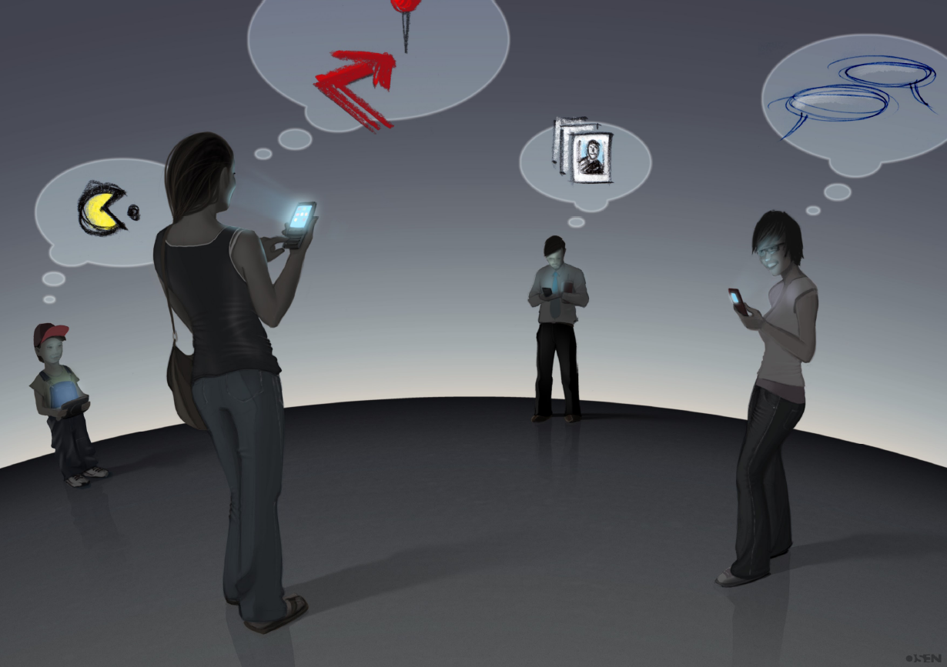
TODAY
Screen dominated interaction
One-at-a-time Services
Minimal Interaction with Environment
Notes:
rough thoughts
single service concepts
inconvenient (notice the guy holding the coffee cup in his arm)
they are focussed on the screen of their devices
people are not so aware of the information environment around them (in the dark)

Slide 6
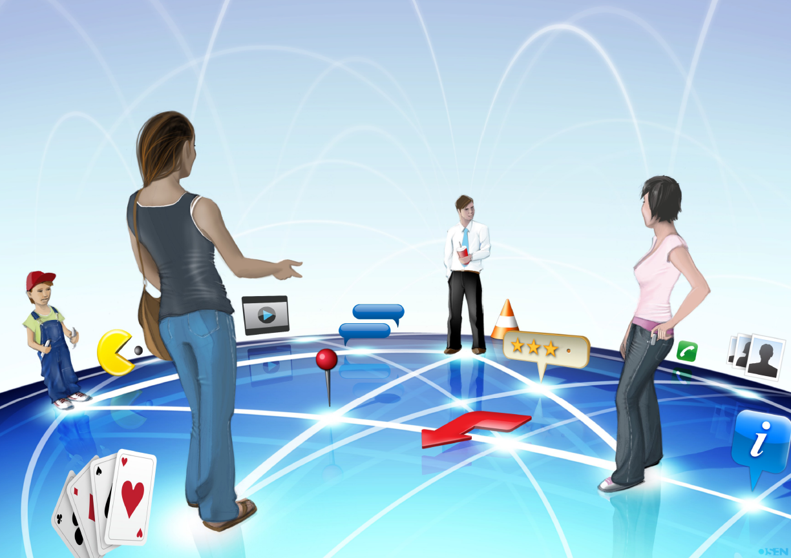
TOMORROW
Relevant People
Multimodal Interaction
Environment
Notes:
now they are aware of others around them
the guy can hold his coffee cup in a manner that is comfortable for him
Focus is not so much on the device, but on the environment
services are shared (note the Pacman in front)
we're no longer thinking about single service concepts anymore – but open ended ones
services are suggested by the environment / context

Slide 7
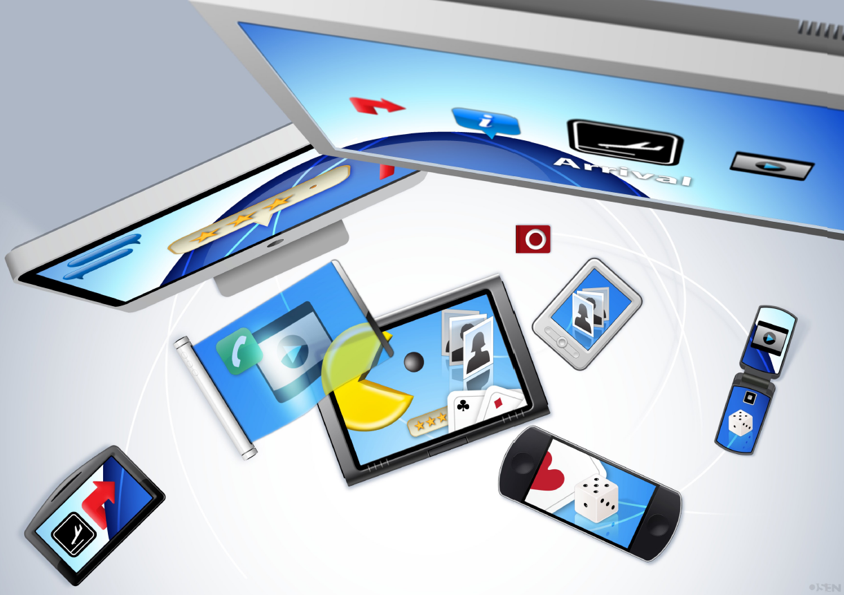
TOMORROW
Most relevant device used in most relevant way
Notes:
The device is no longer the key factor – but what you want to do
each device is a window onto an underlying service
devices may still be specialised for given purposes – but still act as a window from their particular viewpoint
Intercommunication will be integral - we are manipulating the underlying service

Slide 8
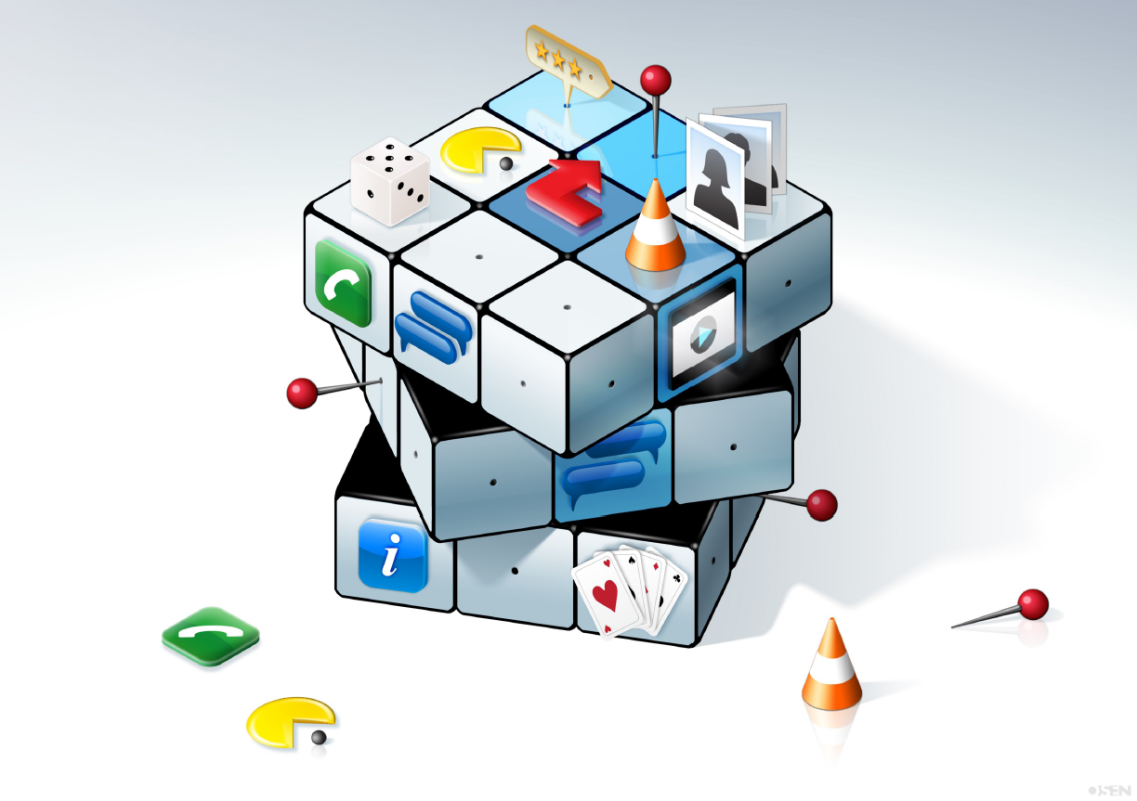
TOMORROW
Dynamically Composable Services
Made aware to user at right time in right way
Notes:
Services no longer monolithic entities which need to be approached
Relevant aspects of each service will be brought together as needed
This will largely be done automatically – depending on user needs and context

Slide 9
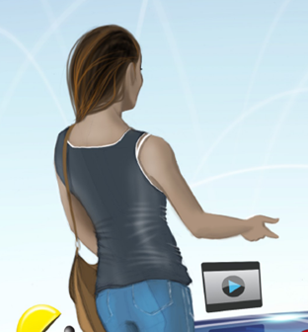


Interacting with Device Ecologies
What Interaction Modalities will best let us interact with multiple
  Devices
  Users
  Services

Slide 10
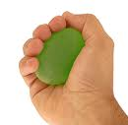

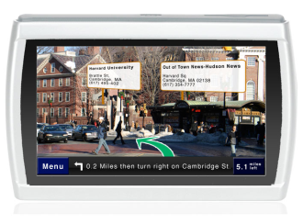
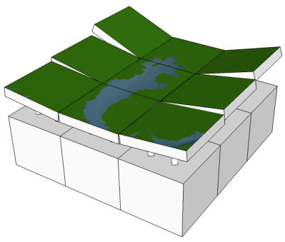



Areas of Research
Pressure
Projection
Augmented Reality
Temperature
Actuatable Displays
Ultrasonic Haptics

Slide 11

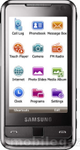

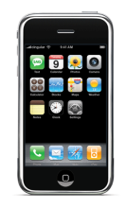





Architecture
Yesterday Tomorrow
Audio/Video Interactions
Multimodal Interactions
Service Providers
Service Providers
Service
Discovery
Agents

Slide 12
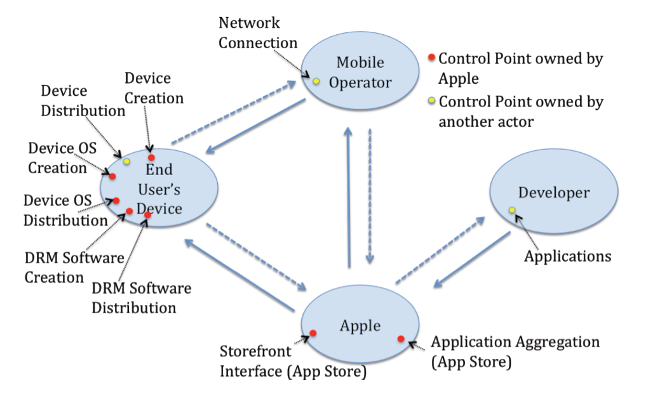
Business Models
Theory of Control Points being developed
Will Help Identify new Opportunities/Strategies for varying types of organisations

Slide 13
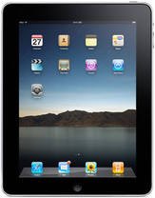
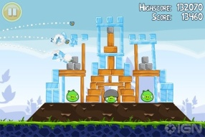
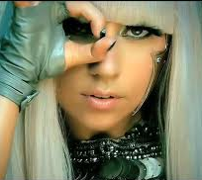
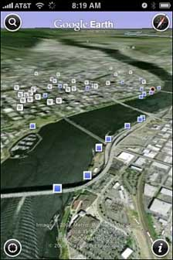
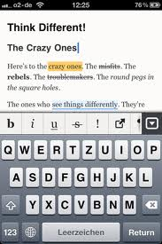
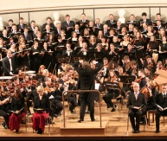
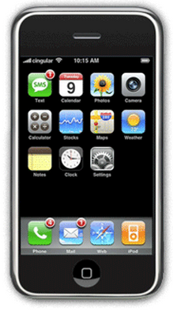







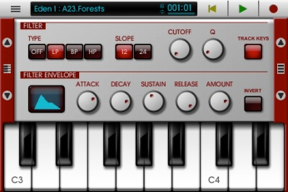
The Platform: Apple
iTunes
App Store
Artists
iBooks
Apps

Slide 14
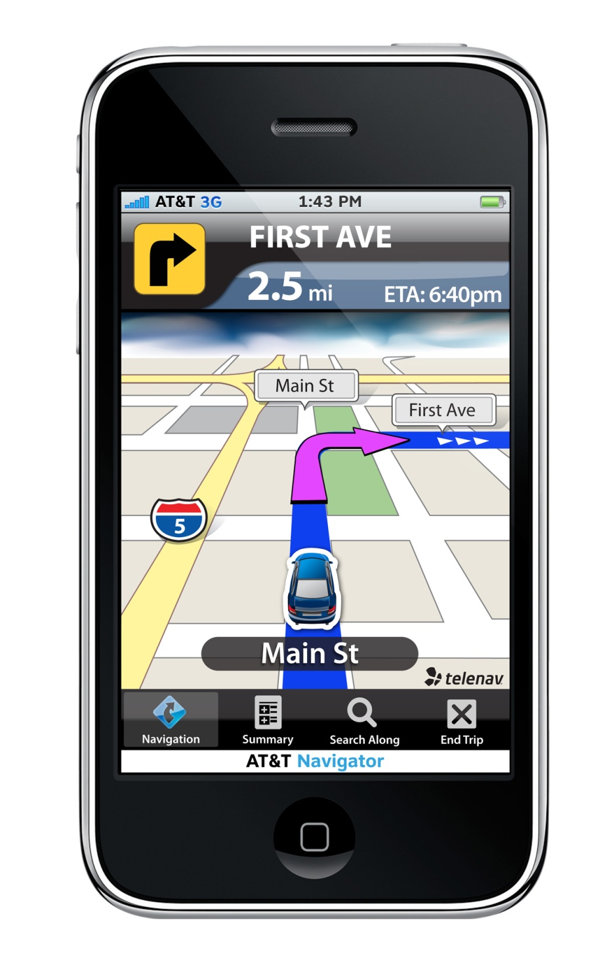
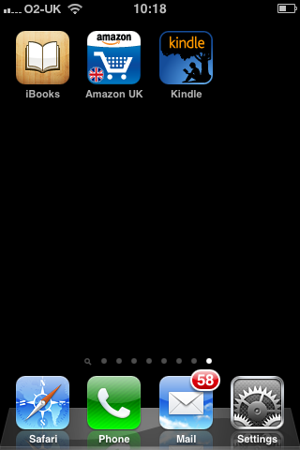
A Tale of 3 Icons

Slide 15






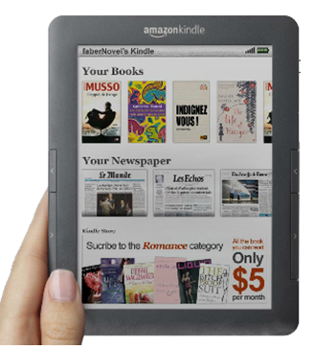
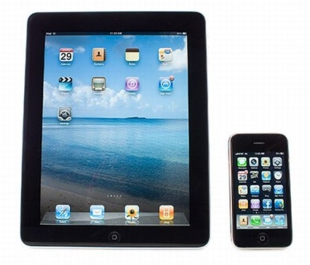
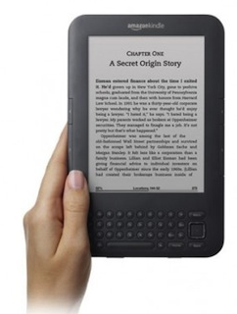

Amazon's Counterstrategy
Amazon Store
Amazon Kindle 'app'
'Others'
iPad /iPhone
Amazon
Kindle reader

Slide 16
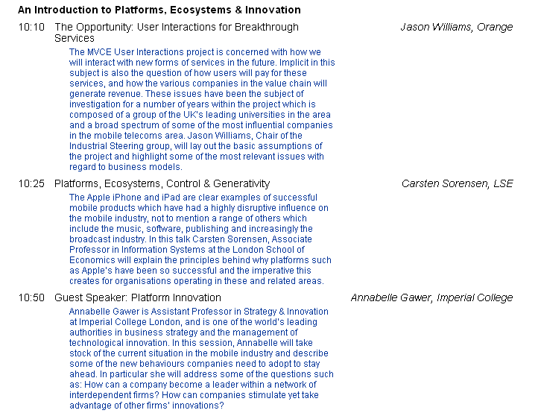
Intro to Platforms, Ecosystems & Innovation

Slide 17
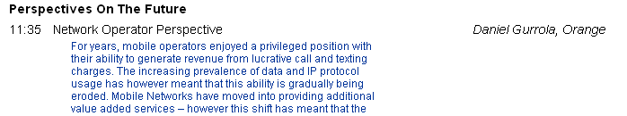
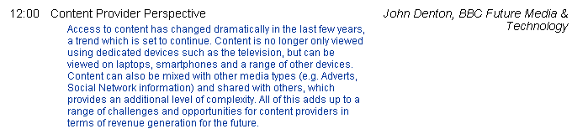
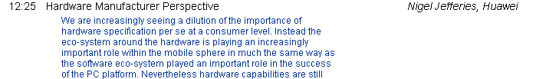

Perspectives on the Future

Slide 18
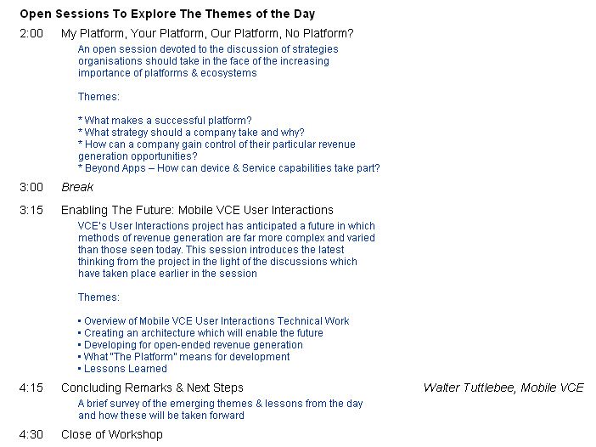
Discussion Sessions

Slide 19

Thank you !

