Slide 1
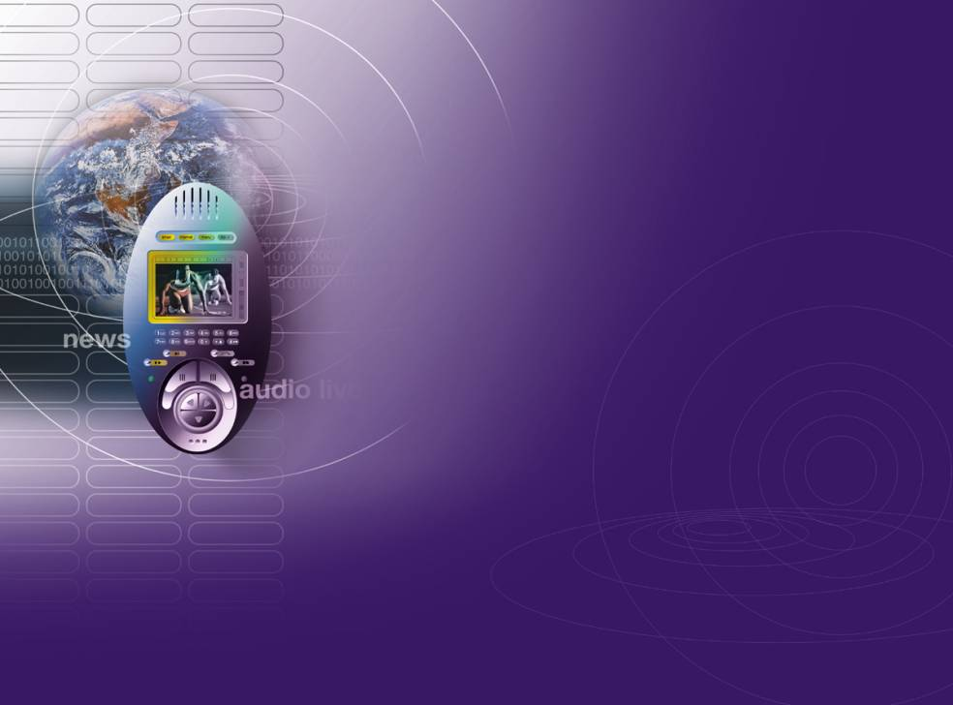

Core 5 Programme
User Interactions for Breakthrough Services
- Annual Research Review
6th October 2011
Jason Williams – Orange
Chairman - User Interactions Steering Committee
Notes:
1

Slide 2
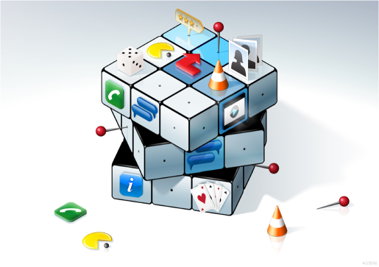
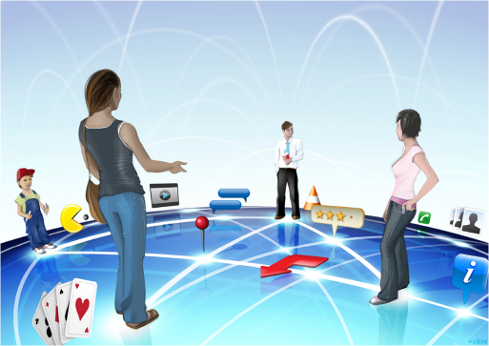
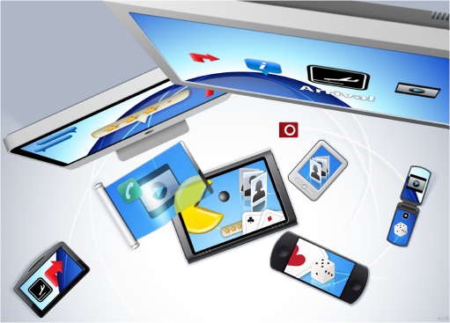




MVCE User Interactions - Overview
2008
2009
2010
2011
To Do
Integration
Packaging-Up

Slide 3
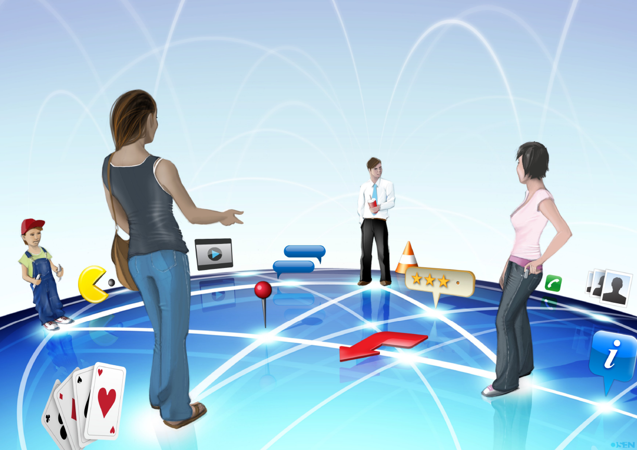
Notes:
now they are aware of others around them
the guy can hold his coffee cup in a manner that is comfortable for him
Focus is not so much on the device, but on the environment
services are shared (note the Pacman in front)
we're no longer thinking about single service concepts anymore – but open ended ones
services are suggested by the environment / context

Slide 4
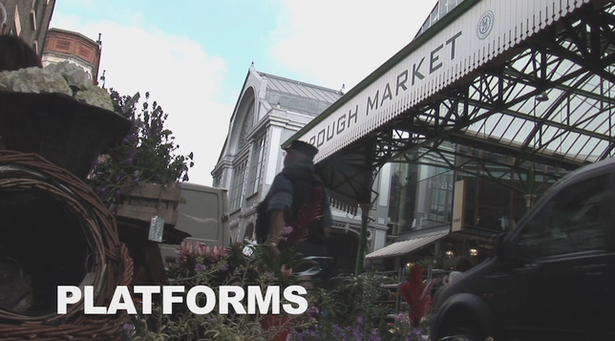
LSE Video: The Platform

Slide 5
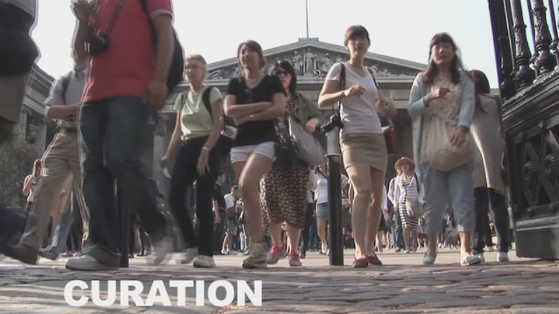
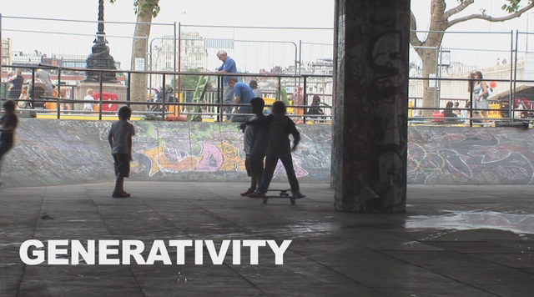
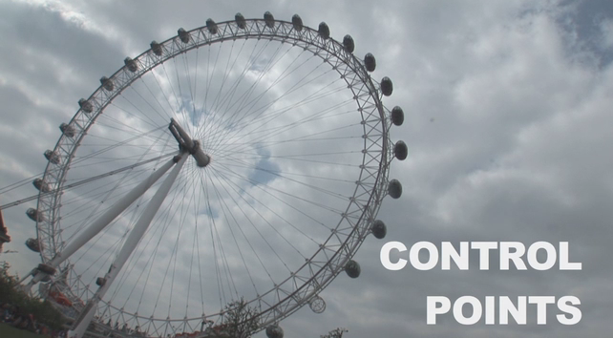
LSE Videos
Videos aim to make complex information
easy to understand
fun
easy to find
amenable to platforms such as YouTube
easy to distribute
give a professional impression of the work

Slide 6
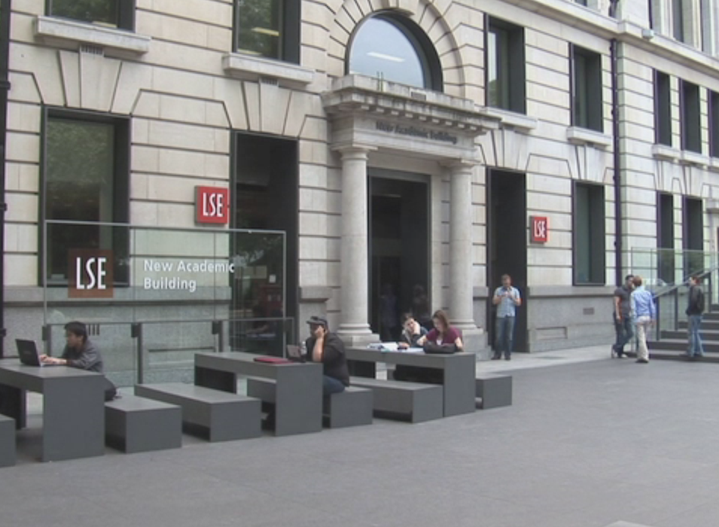
Workshops
Augmented Travelling Workshop
  December 9th 2010, Thales
Business Models Workshop
  May 24th 2011, LSE
Notes:
6

Slide 7

Interaction Techniques

Slide 8
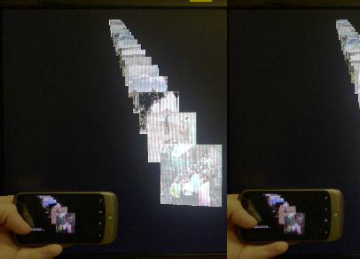
3D Displays
Notes:
8

Slide 9
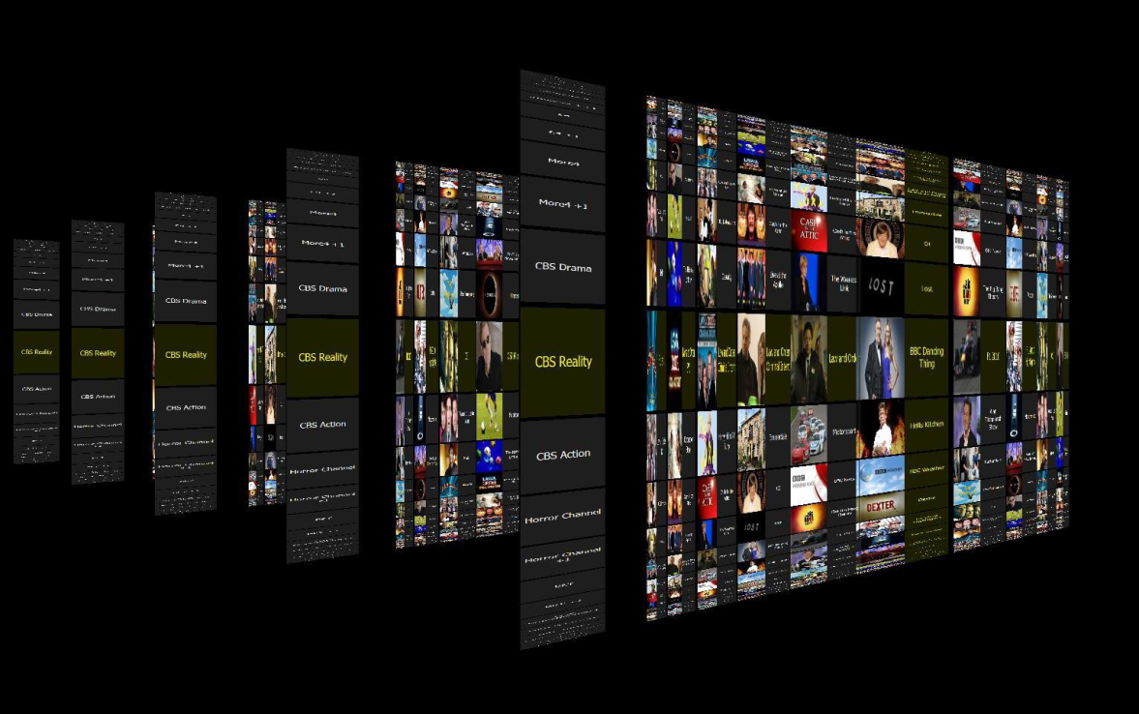
3D Displays

Slide 10
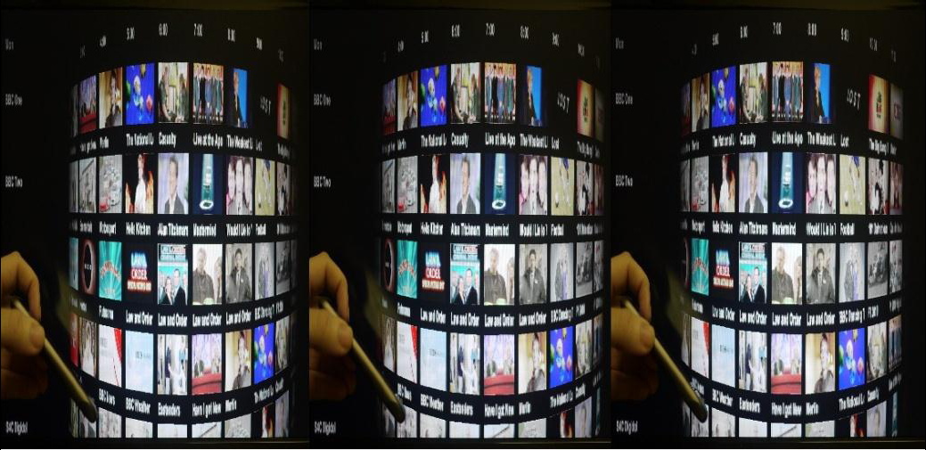
3D Displays
The viewer can preview what is coming later or on a different channel by simply rotating the phone
Notes:
10

Slide 11
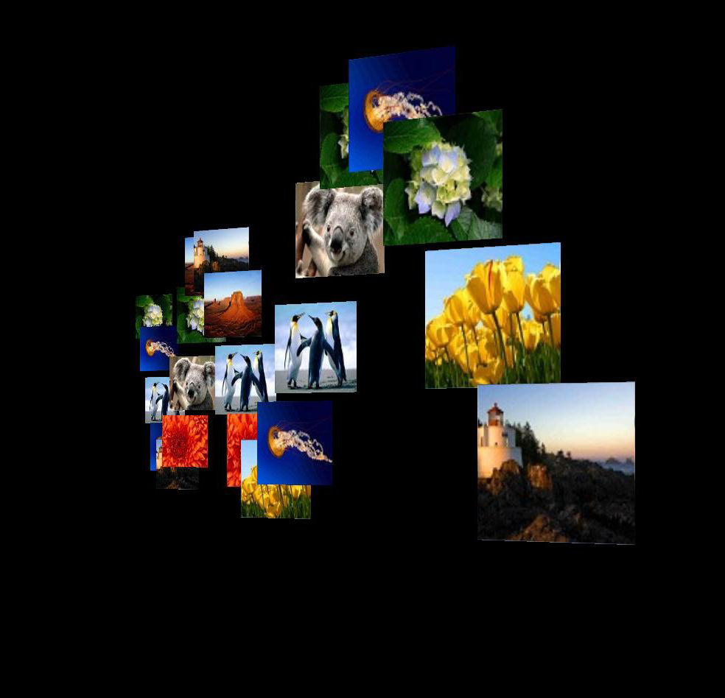
3D Displays

Slide 12
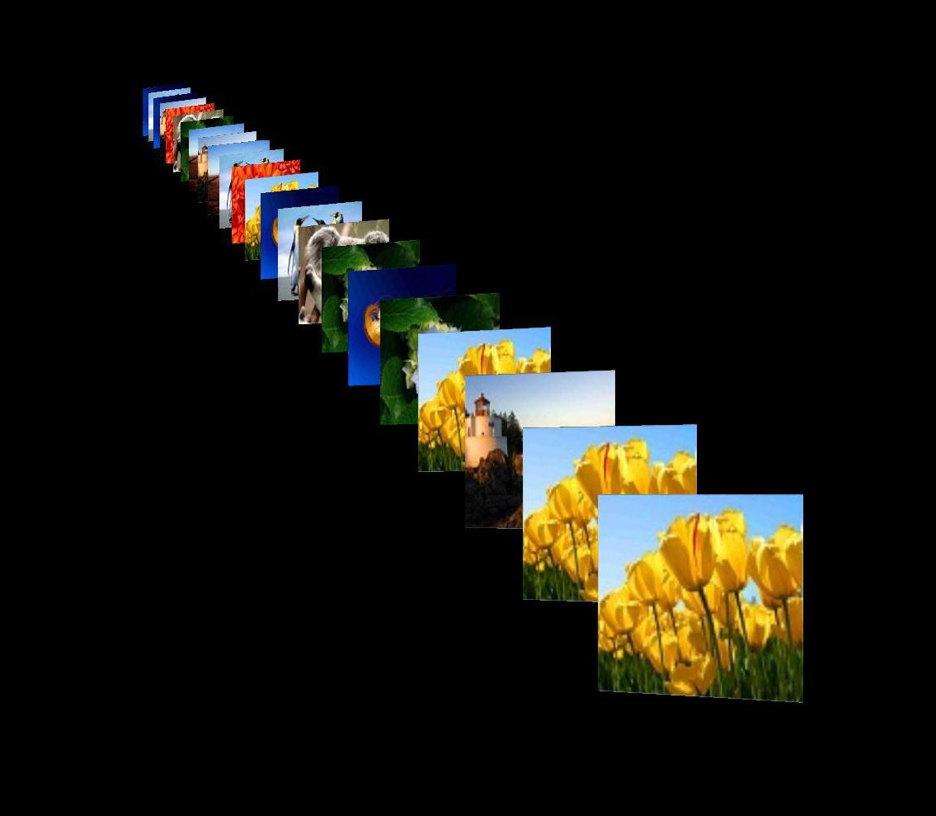
3D Displays

Slide 13
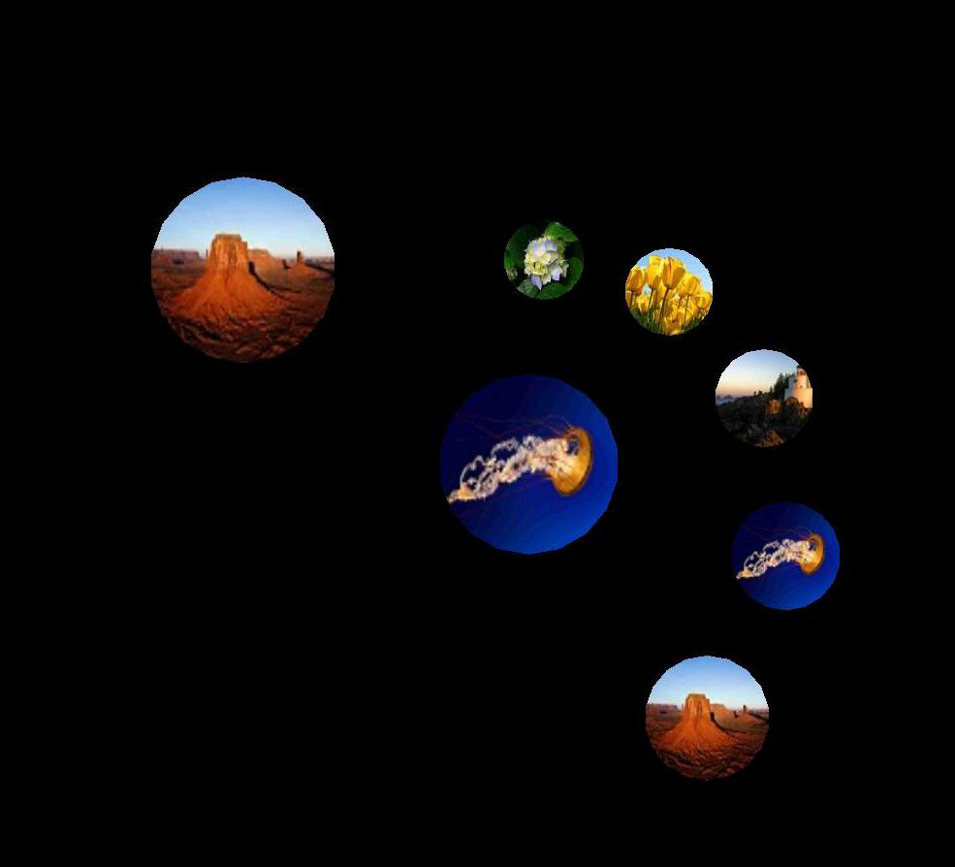
3D Displays

Slide 14
3D Displays
Video
Notes:
14

Slide 15
Pressure Interaction
Created 8-FSR sensor enclosure for grip detection and multi-digit interaction
Notes:
15

Slide 16
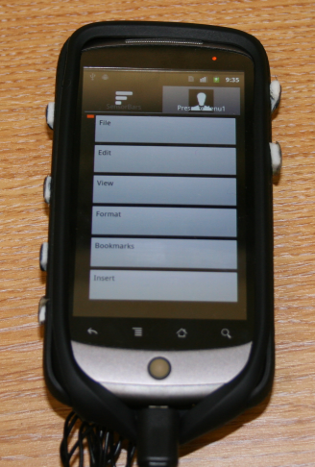
Pressure Interaction
Pressure demo now running on Nexus One
Demos include:
  Map pan & zoom
  Media traversal (rewind/ff)
  List/menu interaction
Notes:
16

Slide 17
Designing grip patterns and interactions
Pressure
Notes:
17

Slide 18
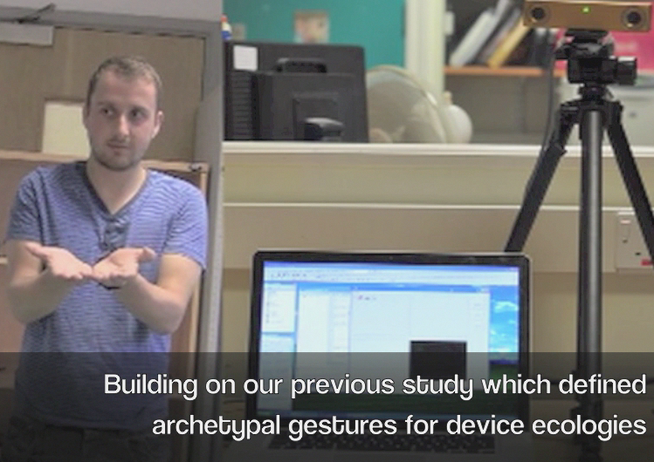
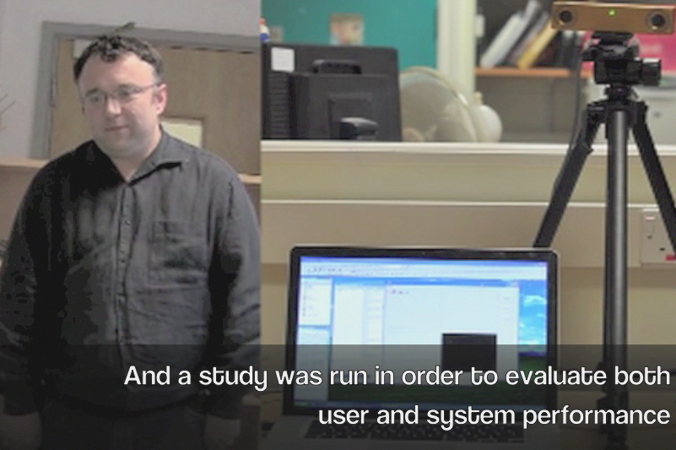
Gesture
Investigation into 'natural' gestures
Design Tool being developed for generating gesture sets which are best matched to task being performed
Notes:
18

Slide 19
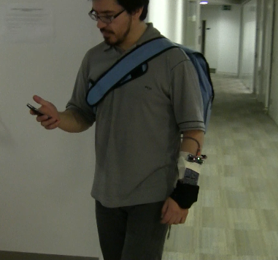
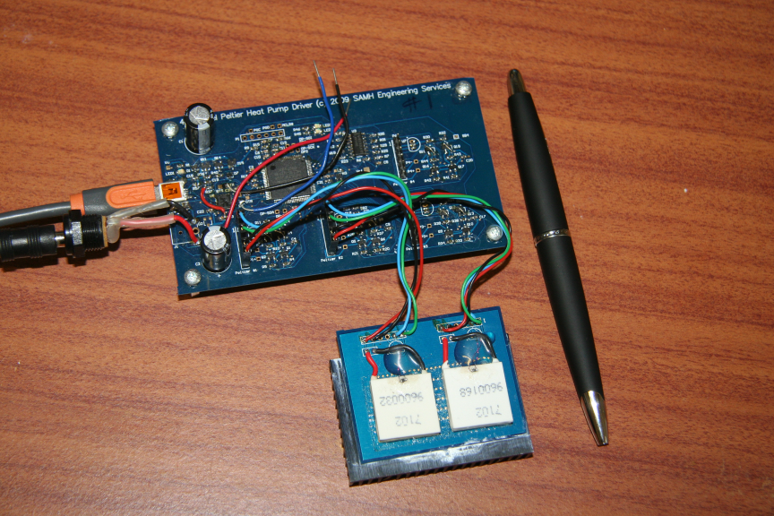
Thermal Interaction
Study into effect of clothing & thermal change complete
Language of ‘thermal icons’ close to completion
Will couple with extra dimension, possibly vibrotactile for three-parameter icons
Notes:
19

Slide 20
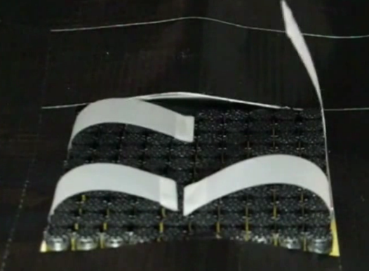
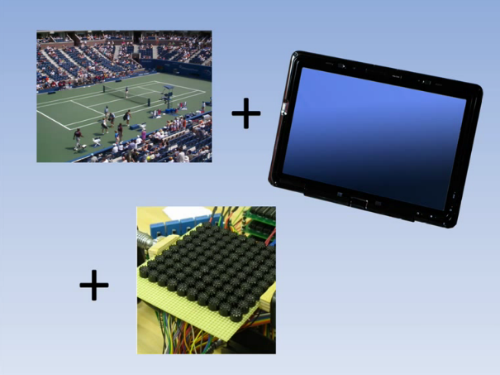
Multi-Point Haptic Interaction
More fine grained actuation of haptics
Demonstrator one step closer to providing resolution needed for Entertainment applications
Notes:
20

Slide 21
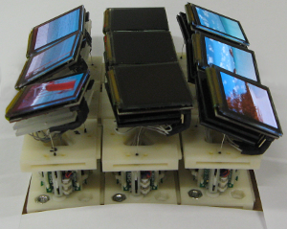
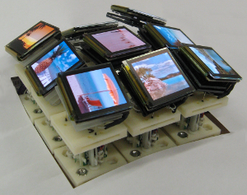
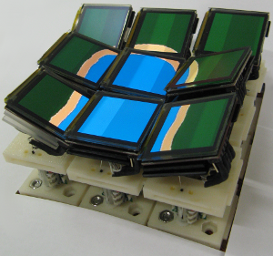
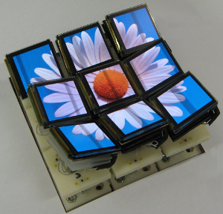
Tilt Displays
Collaboration
Terrain modelling
Artistic expression

Slide 22
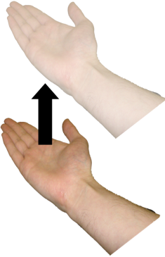
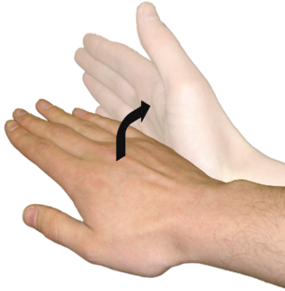
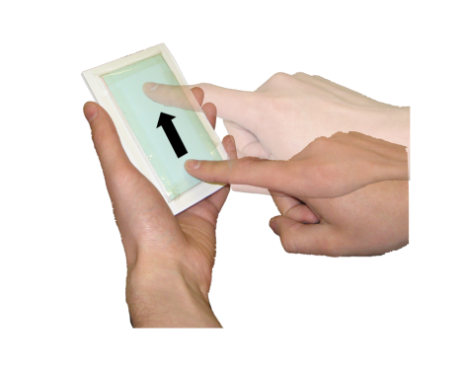
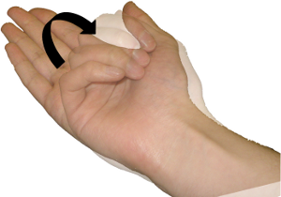
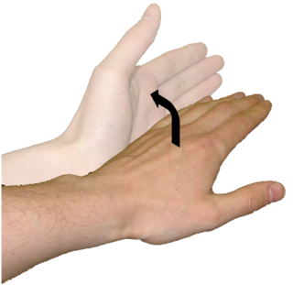
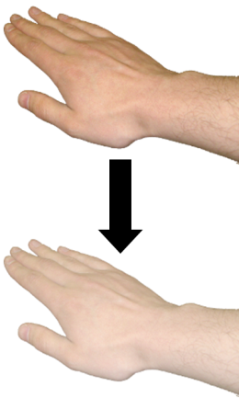
Tilt Displays
Raise screen
Tilt right
Tilt forward
Tilt backward
Tilt left
Lower/flatten screen
User-defined gesture set:
  Above-screen gestures, with strong correlation between physical action and screen movement

Slide 23
Architecture

Slide 24
Architecture Issues
There’s a service for that – Searching/filtering provided by the architecture.
There’s almost a service for that – One “main” service does most of what I want, but not quite. So I need to compose services to “tweak” the service to be what I want.
There isn’t a service for that – Lots of services, each of which provide an element of functionality that I want, composing them is more complicated
Notes:
24

Slide 25
Architecture Components
Based on Universal Plug & Play (UPnP) & Web Ontology Language (OWL)
Consists of UPnP Control Point that interfaces with Peer to Peer Service Network (P2PSN)
UPnP to OWL-S translator makes local devices & services available outside of local network describing their characteristics so they can be reasoned about

Slide 26
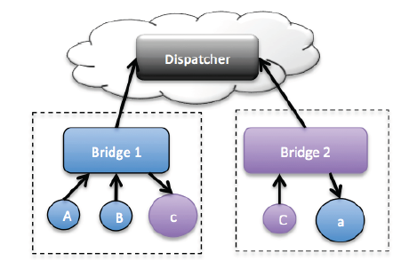
Architecture PoC Demo
Proof of concept developed
Allows interaction and zero configuration to take place across firewalls
Allows discoverability of devices
Scalable to large networks

Slide 27
Principles & Toolkit

Slide 28

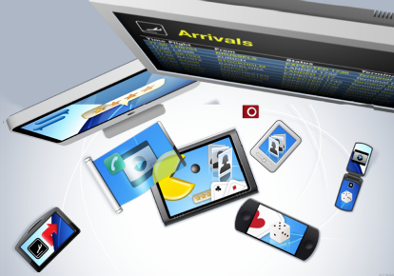
Toolkit & Prototype
Toolkit elements being packaged up
Video
'Minimal' Documentation
API / Code
Prototype underway
Being created according to project themes
Nomadic & Collaborative Media
Augmented Travelling

Slide 29
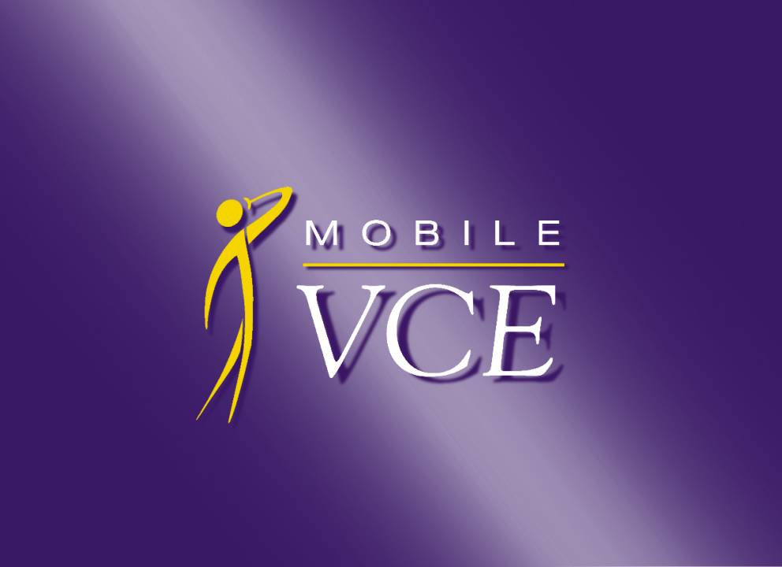
Thank you !

