Slide 1




Core 5 Programme
Green Radio – Sustainable Wireless Networks
Research Review - October 2011
Simon Fletcher
Industrial Steering Group Chair
for Green Radio
V1.0

Slide 2
Presentation overview
Core Mission focus for this year
Proximity to the x100 target
Key Green Architectures
Communicating value
Key integration themes
A shared verification and exploration platform (vcesim)
Communicating the message beyond MVCE and Core5

Slide 3
The Mission for this year…
Green Radio aims to identify:
  New energy efficient network architectures
  Novel techniques to reduce future RAN energy consumption
Initial research focused on developing individual technical approaches following Book of Assumptions
Progress is recorded in the Register of Technologies
Current research includes Integration Activities
  Combining the most promising technical approaches
  Identifying candidate green architectures
Capture key insights leveraging integrative thinking over a series of deliverables due in the next 9 months

Slide 4
Meeting the x100 Target?
Register of Technologies
Colour Key
RF
Op
Tracks | Technical Approach | # Res’ | RF ERG% | OP ERG% | Average ERG%
Cell Deployment | 1. Cell Topology 2. Macro/Femto 3. DAS vs. nonDAS 4. Network Coding 5. Femto vs. WiFi | 5 | 90 46 9 37 32 | 60 66 -10 5 42 | 43, 33
Frequency Management | 6. Spectrum Management | 2 | 50 | 50 | 50, 50
Multihop Relaying | 7. Multihop in LTE-A 8. Mechanical Relaying 9. Scheduling for MH Relay 10. Power Aware Routing 11. PHY Cooperation 12. WiFi Cooperation | 6 | 45 80 89 75 90 37 | 40 - 53 30 - 0 | 69, 31
BS Radio Efficiency | 13. PA Efficiency 14. Antenna Efficiency | 2 | - 50 | 33 - | 50, 33
Interference Management | 15. Beamforming 16. Interf. Cancellation | 2 | 94 83 | 63 22 | 89, 43
Scheduling + RRM | 17. MPRA Scheduler 18. EESB/BEM Sched. 19. Coop Scheduler 20. TD Sleep Modes | 4 | 64 40 26 39 | - 2, 30 5, 26 - | 42, 3.5, 28
ARM
Themes
Theme 1
Architectures
Theme 2
Relaying
Theme 3
Hardware
Theme 4
Scheduling

Slide 5
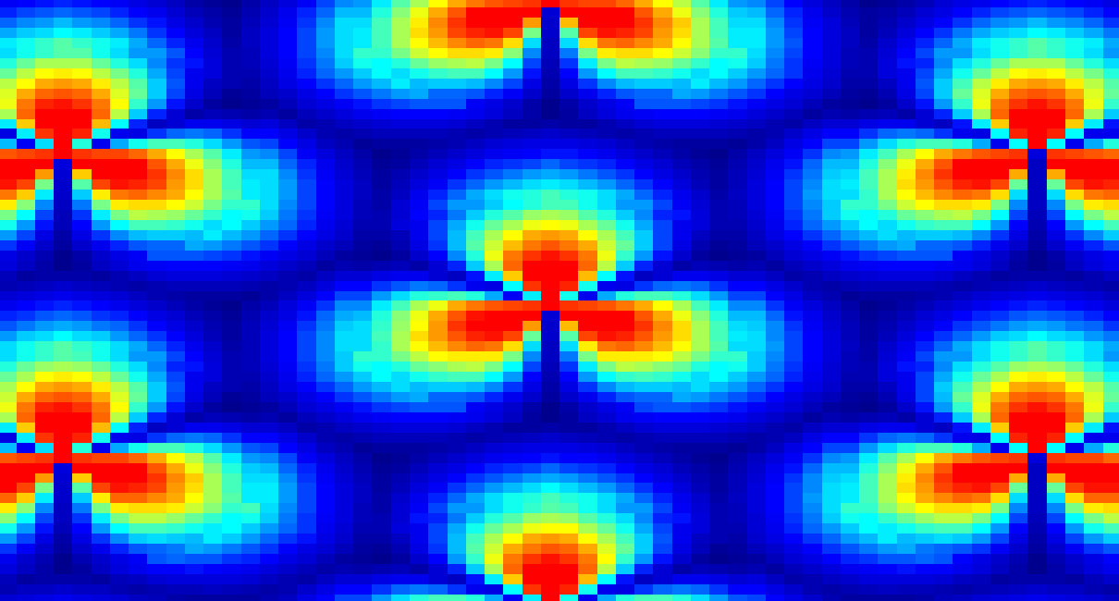
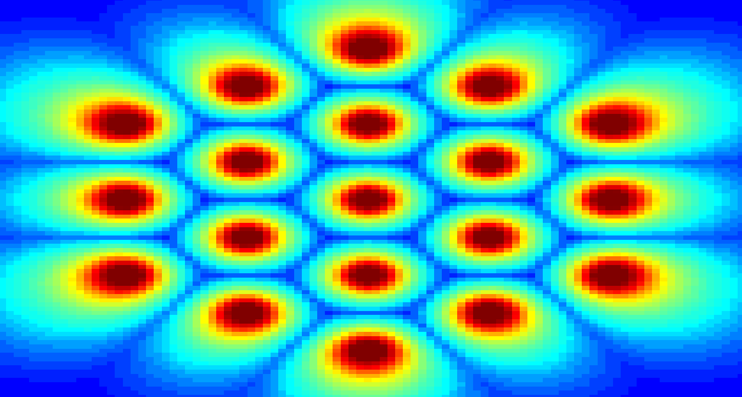
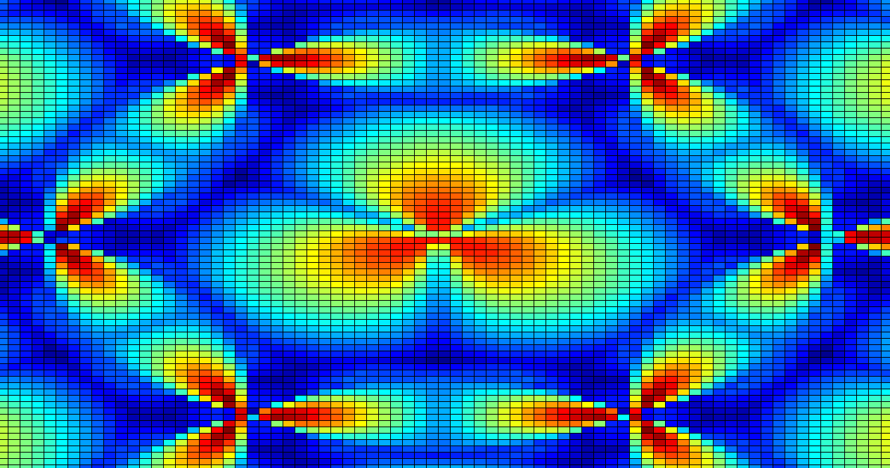
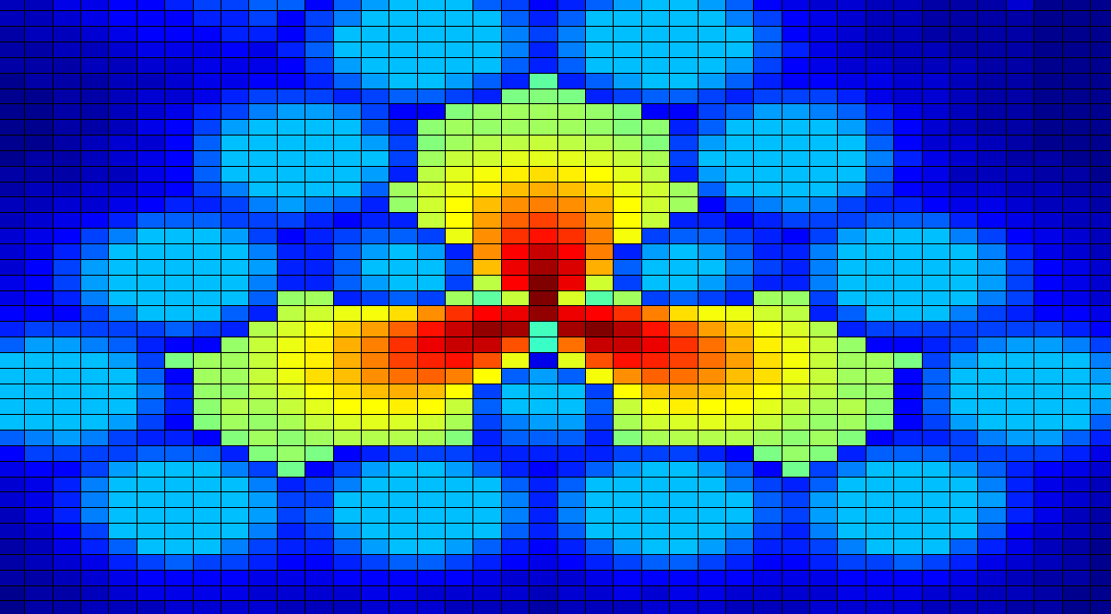
Key Green Architectures
LTE Baseline: Medium Density of Micro-cells
Low Density of Macro-cells with Cell-Edge Techniques
High Density of Low Power Pico-cells
3 Sector Freq. Reuse 1
SISO
RR Scheduler
High Load: 800W/km²
Average ERG: 60%
3 Sector Freq. Reuse 1
2x2 SFBC MIMO
Coordinated Scheduler
Mechanical Relaying
Wi-Fi Offloading
Co-Freq. Wireless DF Relays
High Load: 420W/km²
Average ERG: 79%
1 Sector Freq. Reuse 1
2x2 SFBC MIMO
Coordinated Scheduler
Mechanical Relaying
Wi-Fi Offloading
High Load: 300W/km²
Average ERG: 85%
Operational ERG for HSPA Reference of 3 Sector, Reuse 1, 2x2 SFBC, Micro-Cells
Notes:
It was found that wireless relays generally only benefit large cells and not small cells, hence it is not included in this example and the ERG is lower.

Slide 6
Value Awareness Improvement
System Concept refinement
  Industry briefs -> integrated -> white papers
  Seeking to define capability of required underpinning technology demonstrator

Slide 7


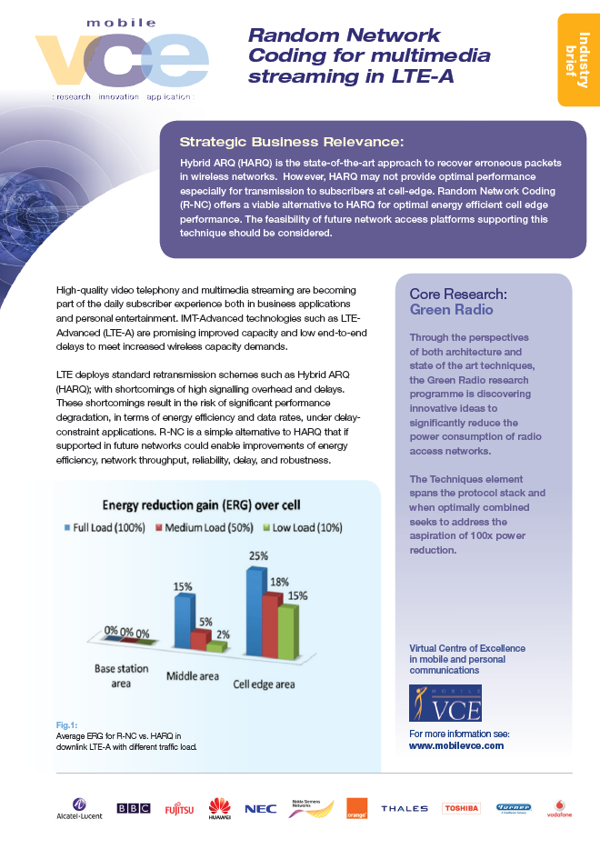

Technology Platforms & Industrial Briefs
Tech Demos: Fibre2Air, PA, Antenna,
Videos: PA, scheduling, Fibre2Air, MechRelay
IBs: PA, Antenna, R-NC, Fibre2Air, WiFi/3G
Platforms: VCEsim, …

Slide 8
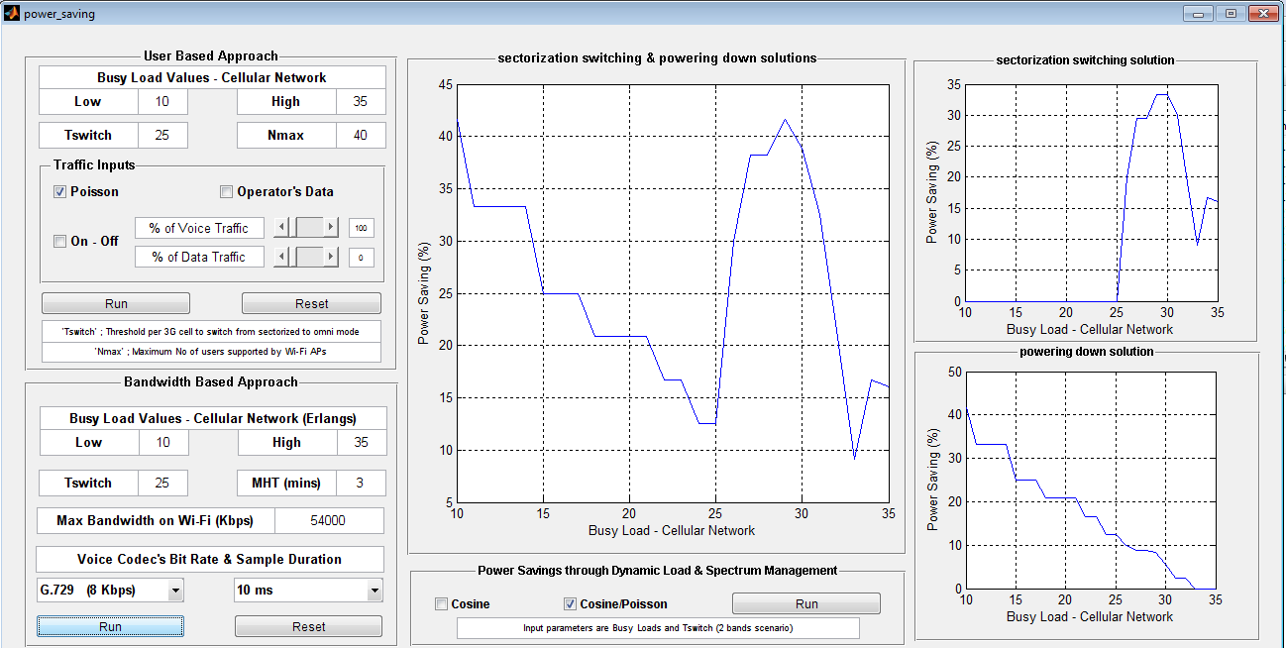
Analytic tools to determine optimal 3G to WiFi energy savings
Powering down 3G radio network equipment (sleep modes) is a sound technique for energy saving.
Coverage & service provision may be supplemented by WiFi.
By turning the base station off at low loads, savings up to 85%. At high loads, the primary contribution is from sectorisation switching, with savings up to 40%
A Graphical User Interface (GUI) has been developed:

Slide 9
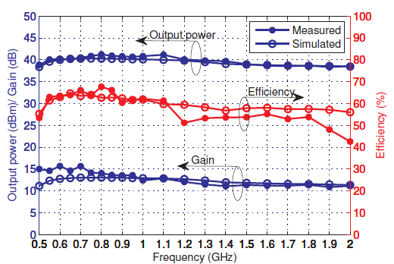
Class J Power Amplifiers
Hybrid Class-J design method has been experimentally verified
Narrowband Class J – Efficiency above 70%
Extended bandwidth hybrid Class J – Efficiency 50-69%
Now optimising Class J operation for Envelope Tracking and Elimination and Restoration (ET/EER) systems
Key Advantages:
Simplified design process
Multiple channels/ standards supported
Efficiency/linearity maintained

Slide 10
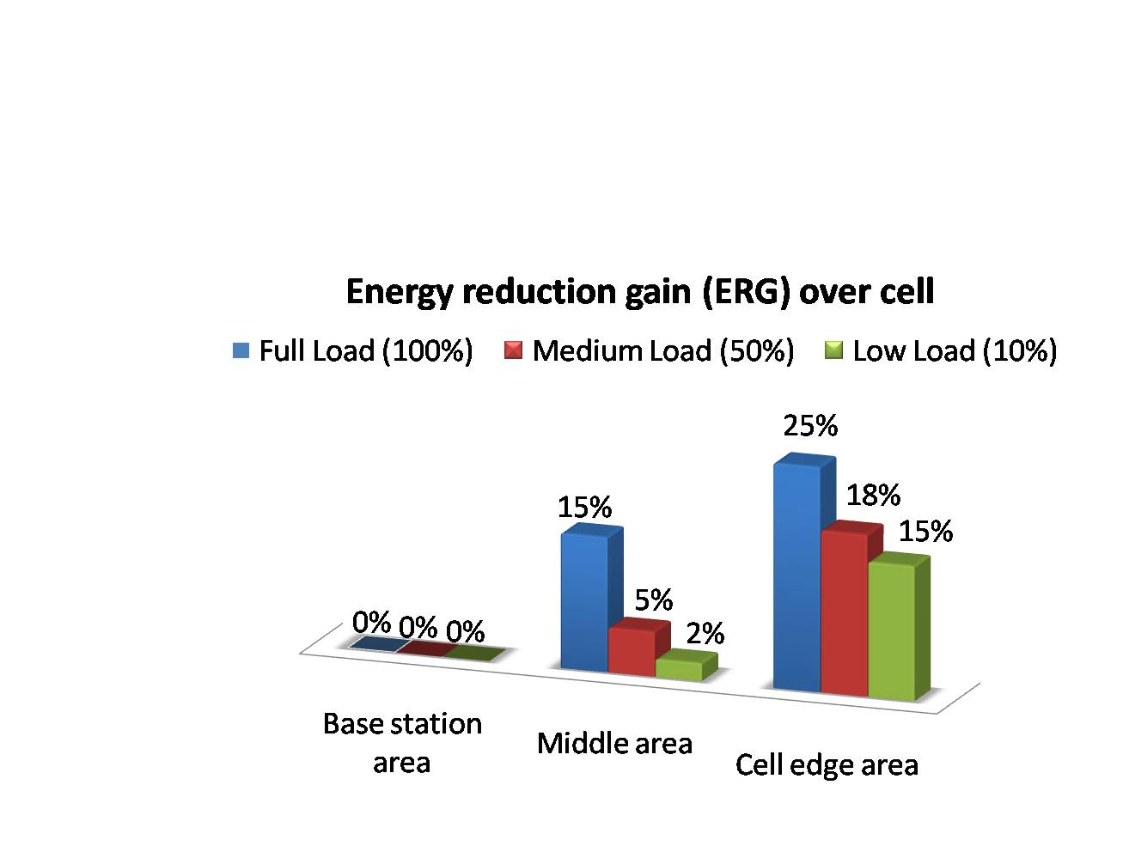
Random Network Coding (R-NC)
R-NC is a rateless code alternative to HARQ in LTE
Downlink data is transmitted to the terminal until the data is decoded and ACK received
Key Advantages:
Reduced Delay
Lower signalling
Better Robustness in Fast Fading Scenarios

Slide 11
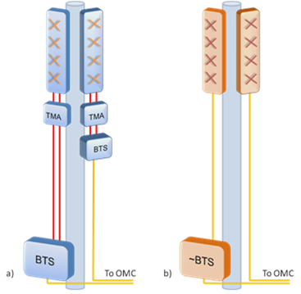
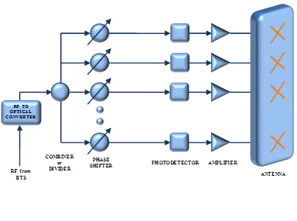
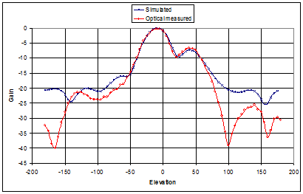
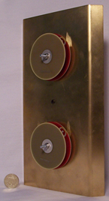
Fibre2Air for cellular Applications
General Configuration of Fibre2Air System
Conventional BTS/PicoBTS
Optical Connection to ~BTS and OMC
Comparison of measured and simulated elevation patterns for a 2 element optically fed antenna
A two element antenna with optical feed

Slide 12
GR Integration Approach
Researchers have documented key energy gain results in the Register of Technologies
Need to be careful about the combining approach
  The benefits of one method may be reduced or cancelled out when combined with another
Developing a Techniques combining matrix to assess whether gains can be added safely
Register of Technologies
×
Energy Combining Matrix
Energy Saving Assessment

Slide 13
GR Integration Approach
Purpose:
  Identify radio techniques that can be successfully combined for energy saving
Integration Methodology:
  Energy Saving Results in Register of Technologies
  Combining Matrix Identifies Combining Gains
  Simulation
Technical Approaches Integrated for scenarios:
  Wide Area Macro: High and Low Traffic Load
  Enterprise (WiFi/Small-Cell): High traffic load, high capacity small cell
  Dense Urban HetNet: Traffic offloading + High and Low Traffic Load

Slide 14
Wide Area Macro:
High Load Techniques Matrix
 | Estimate of ERG [%] | Antenna | PA | Multi-hop Relaying | BS Coop | R-NC | Interference cancellation | Packet Scheduling
Antenna (Lingjian) | 50 RF
PA (Kostas) | 33
Multi-hop Relaying (Panayiotis) (Diogo) (Auon), (Jiayi) | 80 (P) 53 (D) 20 (A) 92 RF (J)
BS Coop (Tuan) | 59
R-NC (Chadi) | 40
Interference Cancelation (Ivan) | 22
scheduling (Bernice) (Charles) | 45 (B) 5 (C)
Full benefit of both techniques
Less than the cumulative benefit of the two
One gain or the other
Unknown interaction on gains

Slide 15
Wide Area Macro:
Techniques Combining Example
Energy Reduction Gain
88%
84%
87%
65%
50%
Antenna
Amplifier
COMP
Interf Cancel
Scheduler
In this example combined gains from 5 techniques
Impact of scheduling lowered by Combining Matrix
Notes:
15

Slide 16
Dense Urban HetNet Integration
Purpose:
  Identify which GR technical approaches support a green RAN architecture for dense-urban HetNet deployments
Integration Methodology:
  System level simulation (VCEsim)
  Analytical (extended RAN capacity equations)
Technical Approaches Integrated:
  Cell size, frequency reuse, MIMO, relays, scheduling, WiFi off-load and mechanical relaying
Technical Approaches to be Integrated:
  Spectrum balancing, beamforming and cooperative transmission

Slide 17
Simulation Integration Framework

Slide 18
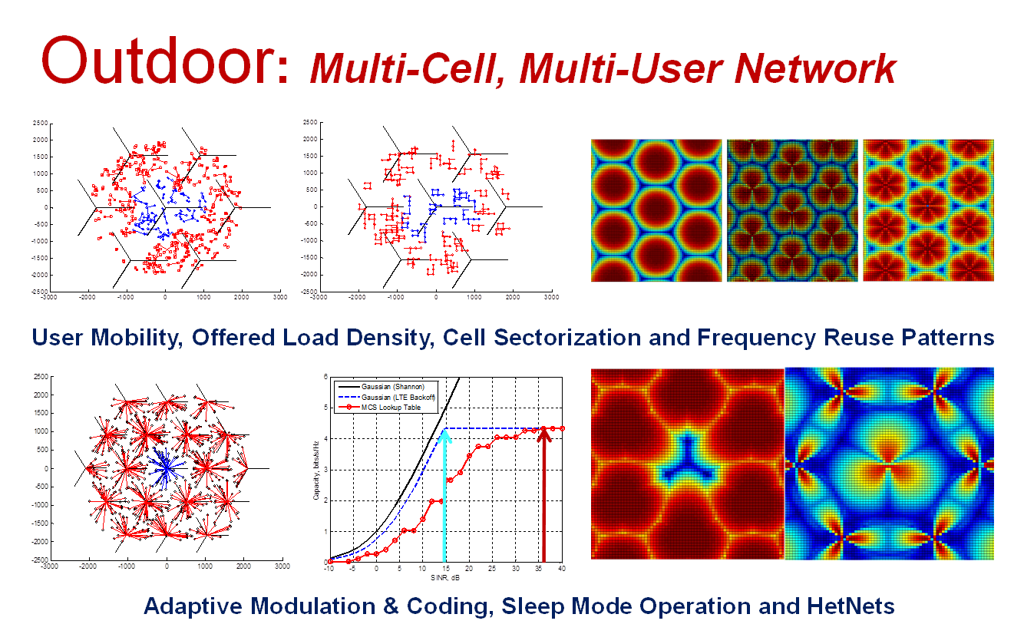
Cell Deployment Framework

Slide 19
Analytical Integration Framework
Captures Key Cellular Network Principles and Techniques
For a given RAN, it’s theoretical mean RAN throughput is:
Number of Cells & Sectors, Frequency Reuse and Size
Saturated Spectral Eff.
& Cell Height
Non-Saturated Spectral Eff.
& Cell Size
For a given RAN, it’s RAN power consumption is:
Number of Cells, Sectors, & Antennas
Overhead
Radiohead

Slide 20
Static Deployment Integration Results
Static Deployment Total: ~70%
Target: 99%
HSPA Baseline
2000W/km²
Multiple-Access: 35%
Cell-site Techniques: 21%
Simulation
Cell-Edge Techniques: 15%
Theory
LTE Baseline
1300W/km²
Offloading
Data: 17%
SIMO, PA Eff. 1000W/km²
Relays,
Coop Sched., 850W/km²
Delay Tx: 15%
Operational Power, W/km²
Wi-Fi Offload 705W/km²
Next Steps:
Re-deployment
Mech. Relay 600W/km²
?
100x Target
20W/km²
Techniques for a Medium Urban RAN Offered Load, 60Mbit/s/km²
Notes:
Here we present integration slides for a constant deployment of same number and location of cell-sites.
Technique implementation notes: Coordinated Scheduler pairs 2 neighbouring cells (including relays) and transmits in 2 player sequential game theory. Mechanical relaying is for an urban mobility model where 100% of the data is delay tolerant for up to 1 TTI (1ms), and UEs that are moving closer to an already camped on cell/relay will delay the downlink transmission. Wi-Fi offloading assumes 30% of the data is traffic and can be offloaded to a Wi-Fi to transmit to a UE, with a Wi-Fi density of 30 per sq km (London density). The relay-UE capacity is limited by the minimum of the cell-relay and relay-UE capacities. The relays are low power 1W decode-and-forward relays placed at the cell-edge.

Slide 21
Redeployment Integration Results
Static Deployment Total: ~70%
Redeployment Total: ~87%
Target: 99%
HSPA Baseline
2000W/km²
Multiple-Access: 60%
Cell Deployment: 30%
Cell-Edge Techniques:
21%
LTE Baseline
800W/km²
Operational Power, W/km²
Offloading:
32%
Cell Size, Freq. Reuse, MIMO, PA Eff.: 560W/km²
Next Steps:
Coop Tx, Beam-forming, Inter-Network Spectrum Sharing?
Delay Tx: 17%
Relays, Coop Scheduling, 440W/km²
Wi-Fi Offload 300W/km²
Mech. Relay 250W/km²
100x Target
20W/km²
Techniques for a Medium Urban RAN Offered Load, 60Mbit/s/km²
Notes:
Here we present integration slides for a constant deployment of same number and location of cell-sites.

Slide 22
Integration…. exposing some promising approaches
Moving to an LTE RAN is energy efficient, building upon LTE-A platform will bring further benefits
Cell size, frequency reuse & MIMO configurations have significant beneficial impact
Improving PA efficiency still essential
Deploying co-channel relays in power grid limited scenarios
Appropriate offload strategies from macro to small cell systems for various traffic/application/signalling types

Slide 23
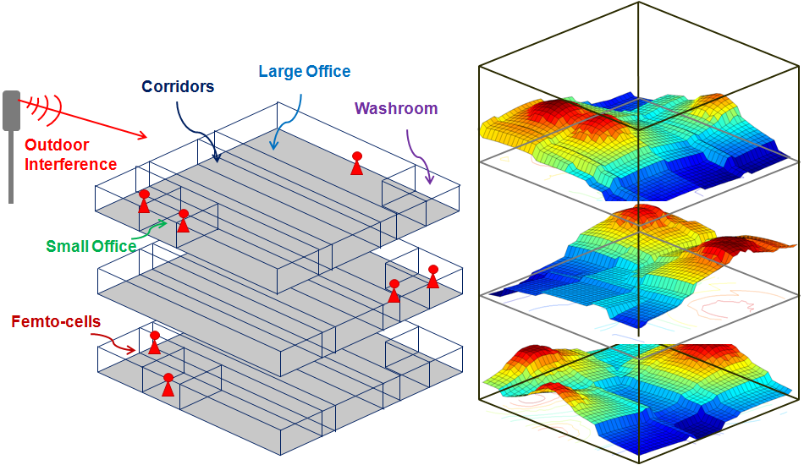
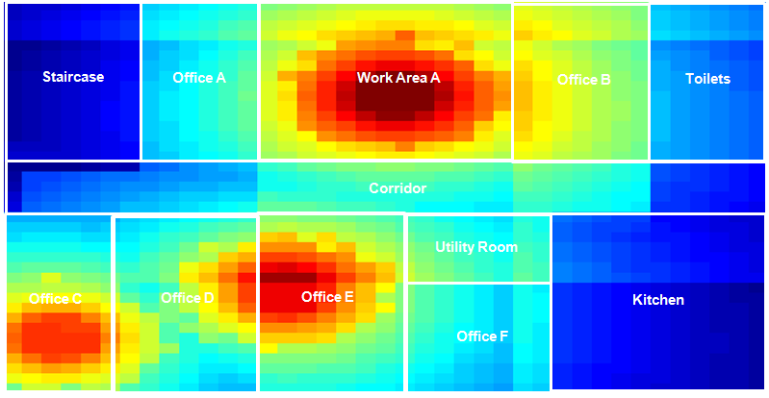
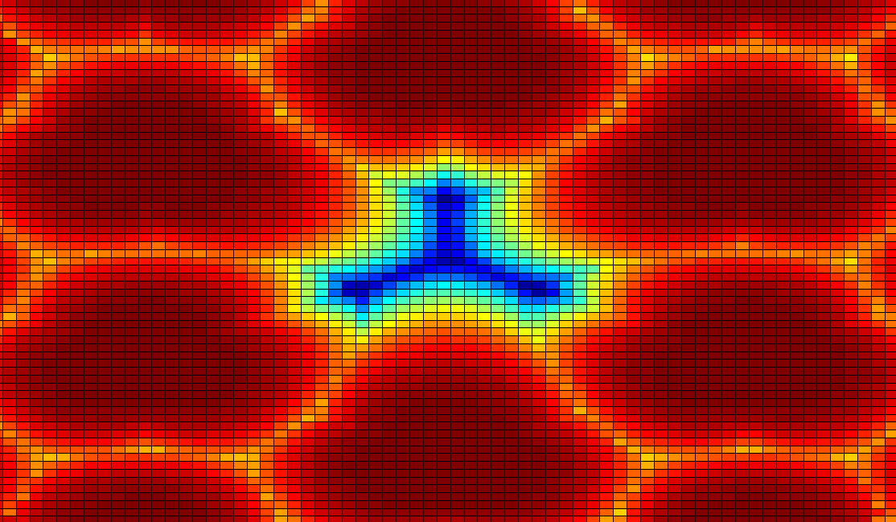
Dynamic LTE Simulator
Multi-Cell, Multi-User, Customizable, Outdoor and Indoor
VCEsim
Dynamic Outdoor Simulator
Sleep Mode
Relays / DAS
3D Indoor Building with Indoor and Outdoor Interference
http://www.mobilevce.com/pmwiki5G/index.php?n=Main.VCESIM

Slide 24
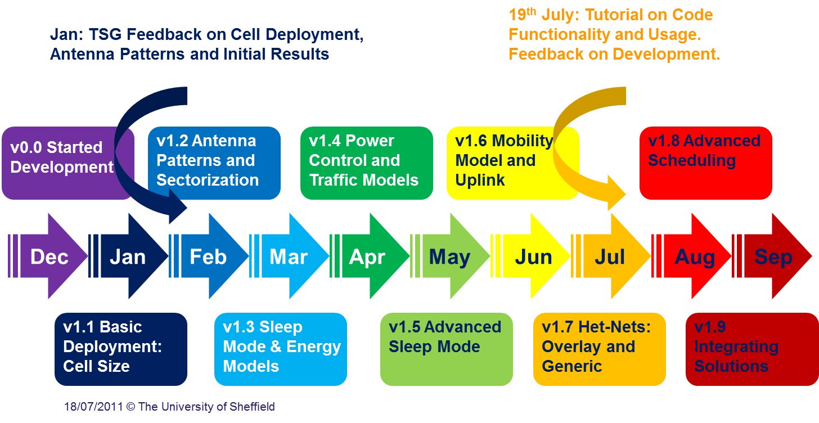
VCEsim Development

Slide 25
Dissemination Highlights
Peter Grant gave invited presentation at IEEE Globecom, Dec 10, Miami (1500 attendees)
Presentation at Cambridge Wireless Research Event, Jan 11
Green Session at Mobile World Congress, Barcelona in Feb 11
Organised VTC Greenet Workshop, Budapest in May 11
ICT-KTN Workshop on Green Radio in Reading, Jun 11
  Green Radio Paper top download position
Overview Paper Published in IEEE Communications Magazine, Jun 11, was top ten download from IEEE Website
Green Workshop colocated with Wireless Innovation Forum, Brussels, Jun 11
Tim O’Farrell EURASIP EUSIPCO2011, Invited Paper, Aug 11
Tim O’Farrell OPTNet2011, Key Note Presentation, Spt 11
John Thompson to give invited presentation at IEEE WICON Conf in China, Oct 11
Vasilis Friderikos to give invited presentation at IEEE Globecom workshop, Houston, Dec 11

Slide 26
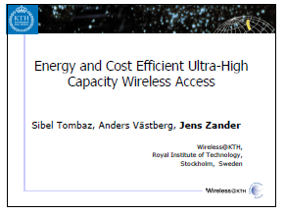
Greenet Workshop May 2011
Organised One Day Workshop co-located with VTC Spring Conference in Budapest
Workshop attracted 50% papers from industry, 50% from academia
Keynote addresses from David Lister (Vodafone), Shugong Xu (Huawei) and Jens Zander (KTH)
More Information about the workshop is here: http://www.see.ed.ac.uk/~jst/Greenet/

Slide 27
Conclusion on GR impact to date
High global conference visibility
  Leading GreeNet at VTC 2011 and 2012
  3 book chapters contributed
  Wiley book on Green Radio
  Many invited paper and talks
Thought leading on the research agenda
  Seeded GreenTouch, EARTH
  Mechanical relaying, R-NC, Class-J PA, Antenna steering techniques, Mesh
  System integration
GR tools and research platforms used by industrial members
GR points to a feasible route to an average of x10 energy reduction
  sensitivity analysis and optimisation based on traffic awareness to be characterised.
  Results are constrained by existing basestation models, new energy profiles for Green Radio Access equipment needed.

Slide 28
Acknowledgements
Contributions from:
  Tim O’Farrell (Academic Coordinator)
  John Thompson (Deputy Academic Coordinator)
  Simon Armour (WP2 Leader)
  Vasilis Fridericos (WP1 Leader)

