Slide 1
Industrial Steering
Opportunities arising from the UK-China Science Bridge
Research Review - October 2011
Simon Fletcher
MVCE UKCB Steering Group Member
Green Radio Industrial Chair
With thanks to Dr. Cheng-Xiang Wang of Heriot-Watt
http://www.ukchinab4g.ac.uk/
V0.1

Slide 2
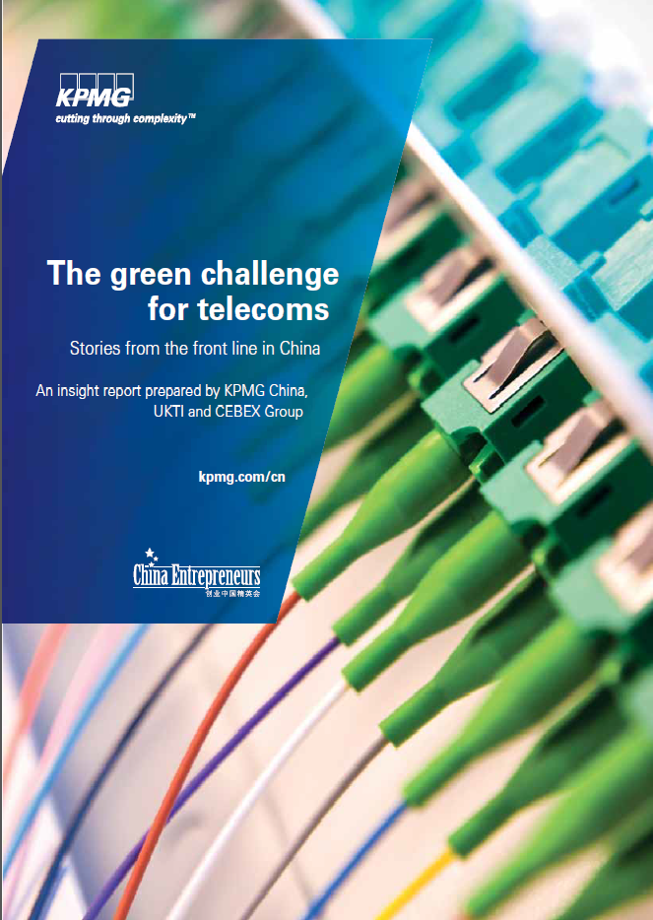
High common interest in the area of Green Technologies in the UK and China
2009: Tour of Universities and Industrial partners, Green Radio was clearly a common interest.
2010: Green Communications Leadership Forum at Huawei, Shanghai
Continues to seed engagement opportunities in partnership with UKTI

Slide 3
UK-China Science Bridges:
R&D on (B)4G Wireless Mobile Communications (UC4G)
Project Achievements
Overview:
Aim: To create a UK-China Joint R&D Centre for Future Wireless Communication Networks, enabling long-term sustainable collaboration between the UK and China
Duration: 3 years (01/08/2009-31/07/2012)
Funding: £1,134,442 (fEC) or £907,554 (RC contribution)
Collaboration Consortium: 17 universities and 7 companies
Achievements Highlights:
Publications: 17 journal papers and 16 conference papers including 3 best paper awards and 1 invited paper
2 Joint patents (1 awarded, 1 in application); 3 Joint projects
28 UK-China visiting fellowships awarded; 6 Workshops
Open-access UC4G wireless MIMO testbed (4 x 2); ready to demonstrate Spatial Modulation techniques on the UC4G testbed

Slide 4
UC4G Achievements
Joint Patents:
H. Haas, R. Mesleh, I. Stefan, and P. M. Grant, "A method and system of enhanced performance in communication systems," international publication number: WO 2010/094960 A1
H.-J. Tang, K.-F. Tong, and W. Hong, “Low profile three-dimensional orthogonally polarized antennas,” international patent, in application.
Joint Projects:
Heriot-Watt University, “Realistic MIMO Channel Models for 3GPP LTE and IMT-Advanced,” Supported by Huawei Technologies, £114,968.00, 02/05/2011-01/05/2012.
Datang Telecom, Beijing University of Post and Telecommunications, and University of Surrey, “Cognitive Radio Research Based on TD and Evolutionary Technologies,” Supported by the Ministry of Science and Technology (MOST), China, RMB 5.5 million, 2010-2013.
Shanghai Research Centre for Wireless Communications (WiCO), University College London (UCL), and British Telecom (BT), “Analysis, Modelling and Demonstration of Future Wireless Broadband Traffic and LTE-TDD Relay Technologies,” Supported by the Ministry of Science and Technology (MOST), China, RMB 5.03 million, 1/12/2008-30/11/2011

Slide 5
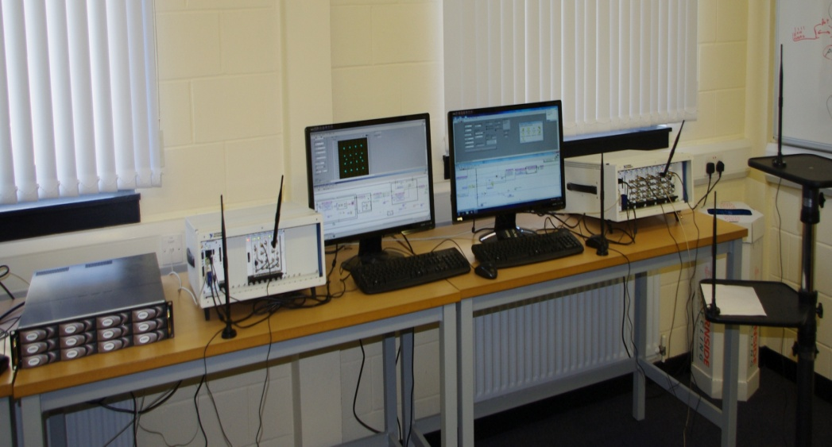
UC4G Wireless MIMO Testbed (1/2)
Hardware specifics (NI PXI products):
Tx → Right-hand side – 4 RF chains
Rx → Left-hand side – 2 RF chains
Hard-drive array (RAID)→ Extreme left-hand side: 6 TBs memory
Tx frequency range (85 MHz – 6.6 GHz)
Rx frequency range (10 MHz – 6.6 GHz)
Tx RF bandwidth: 100 MHz
Rx bandwidth (3dB): 50 MHz
Embedded FPGA (Xilinx Virtex 5) at the Tx & Rx for real-time signal processing
Embedded PCs at the Tx & Rx with Windows 7, LabView , Matlab, & NI software
Current capabilities/demos:
Offline ‘Spatial Modulation’ system
Offline 4 x 2 MIMO-LTE system
Real-time simplex SISO-WLAN system
Developing:
Novel ‘Spatial Modulation’ techniques
Channel emulator

Slide 6
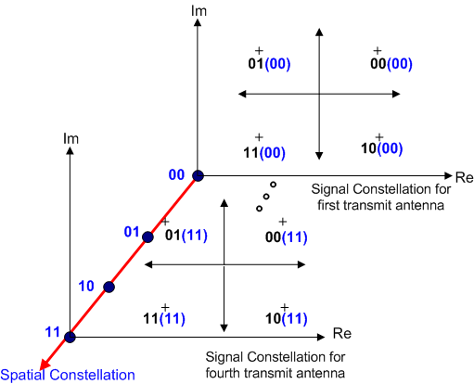
UC4G Wireless MIMO Testbed (2/2)
Claims for Spatial Modulation:
A novel technique that utilises multiple–antenna transmission to realise an entirely new modulation concept
Only one Tx antenna is activated at a time: a ‘green’ MIMO solution
Better than existing MIMO techniques with low system complexity
Expected to be a key contender for physical layer techniques for B4G wireless communications standards
The UC4G project has been the first to demonstrate this new technique experimentally.

Slide 7
Can we leverage assets towards 5G Proof of Concept activities?
Renewed interest in (massive) MIMO systems
Core6 visions discussions point to short comings in RF component and system solutions
Renewed interest amongst stakeholders in VCE, KTN, Cambridge Wireless in seeking UK research in this technology domain
Consensus in the industry is balancing EE and SE characteristics of networks toward 2020 (early 5G) will be essential.
TD-LTE and FD-LTE now converged in the LTE-A era, full duplex solutions now being investigated to enable BTSs to increase system throughput
Bristol (and others) have carried out research in these areas ~10years ago….it’s time to evaluate the capability of the open testbed provided in UKCB.
Advance the discussions about research and verification leveraging this testbed.

